Slide 1
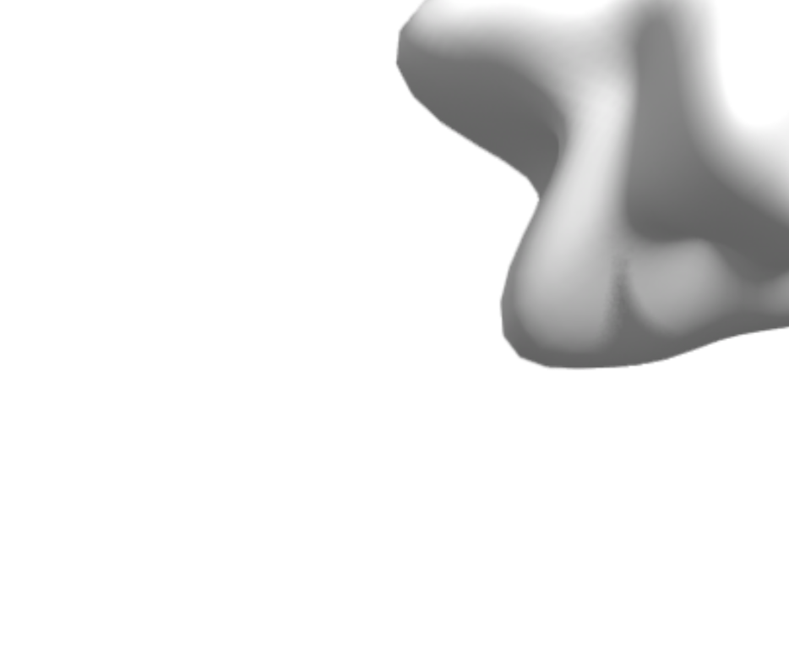


ARE YOU READY
FOR THIS?

Slide 2
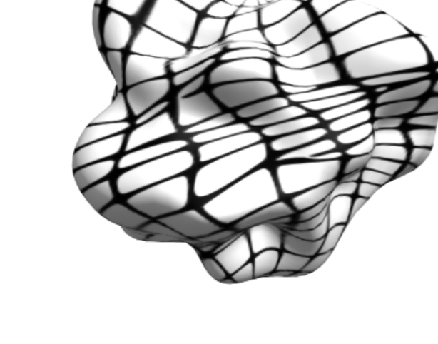

TO BECOME A GREAT
DESIGN SUPERHERO

Slide 3


ABOUT ME
Name: Francis Odeyemi
Birthplace: Ile-Ife, Osun State
Relocation: Moved to Lagos in 2018
Current Occupation:
Senior Product Designer
Dietary Habits: Consumed spaghetti over 1,203 times since 2019 (5-6 times a week)
Entrepreneurship:
Founder of Ninthgird, an Afrocentric media company that focuses on providing a diverse range of Afrocentric stock images, videos, illustrations, and creative assets for your business and creative needs.
Design Career: Commenced design career in 2013, and currently, with a decade of experience, still actively engaged in the field

Slide 4
I WILL BE GIVING A TALK ON
GROWTH SECRETS FOR
DESIGN SUPERHEROES

Slide 5











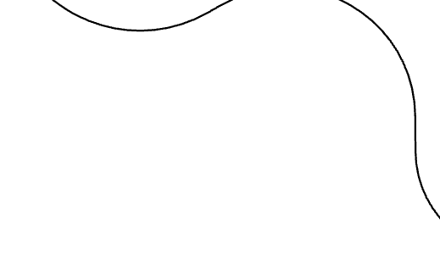


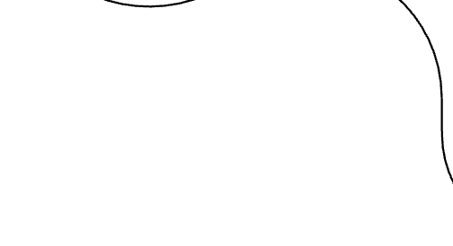

















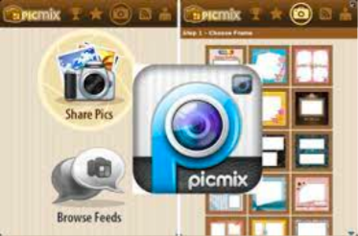
MY STORY

Slide 6
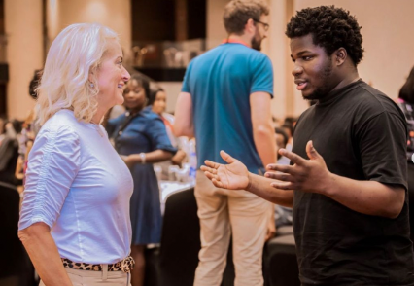
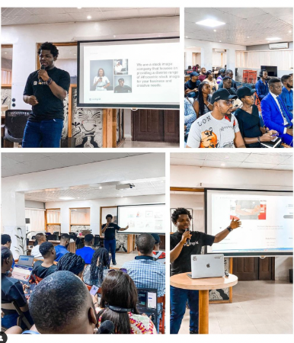
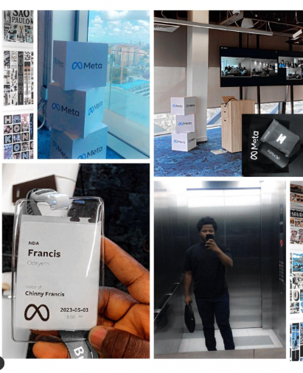
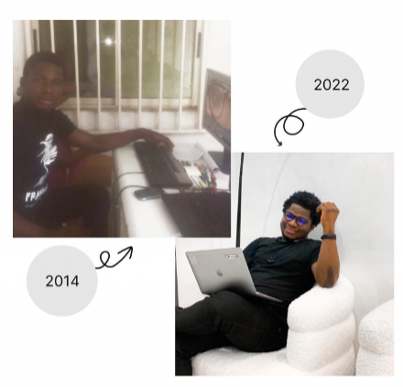
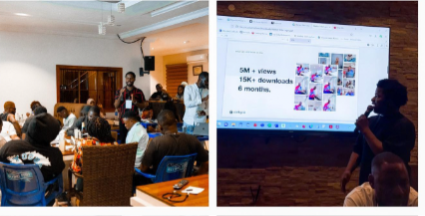





HOW FAR...
My design journey has been a fascinating evolution—from graphics designer to brand designer, then diving deep into product design and eventually stepping into the realm of design leadership.
I've had the incredible opportunity to collaborate on projects with renowned brands like Samsung, Sterling Bank, Meta, Cregital, Purelife Pharmacy, and Vivano.

Slide 7

MAIN POINTS OF THE TALK:
1. Using Your Gut
2.Communication
3.Ownership
4.Collaboration

Slide 8


























































1. USING YOUR GUT
Sometimes clarity is crystal clear; other times, your thoughts are clouded with uncertainty. But here's the thing: do it anyway. Trust your instincts, even when shadows loom. The best decisions often come from that gut feeling.
Notes:
Talk about your decision to move to lagos, starting ninthgrid from taking photo with iphone and uploading on unslaph and with countless of decisions you have to make daily as designer.

Slide 9













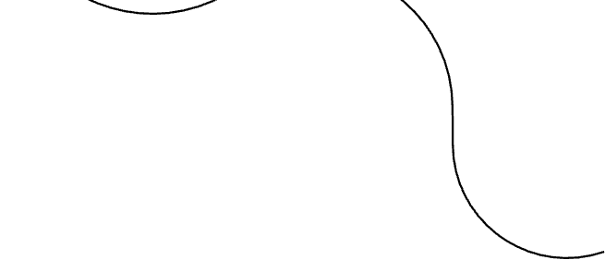












































2. COMMUNICATION
Do what you say, when you say you'll do it. Effective communication is the backbone of any superhero. It's not just about talking the talk; it's about walking the walk. Consistency in your words and actions builds trust and credibility.
Notes:
Effective communitation for career visibilty, communication in teams,

Slide 10























































3. OWNERSHIP
You don't need a title to be responsible. The more responsibility you take on, the more in charge you become. Don't wait for permission; step up, own your work, and watch how it propels you into a leadership role.
Notes:
tlak about how

Slide 11
















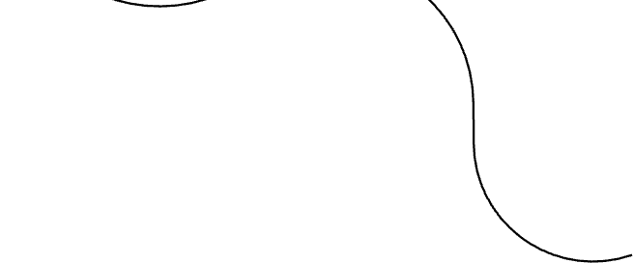









































4. COLLABORATION
Even Jesus had disciples. You can't do it alone. Delegate, trust, and share your work with others. Collaboration is the secret sauce to success. Embrace it, and together, we'll achieve design greatness.

Slide 12
























GOT QUESTIONS FOR ME?

Slide 13

THANK YOU!
Follow me on Instagram
and LinkedIn @francisodeyemi

